Slide 1
University Model Implementation
Authored by: Rahul Tiwari (001568172) Anurag Shrivastava (001568861) Shreya Kichloo (001306118)
Team No 19

Slide 2
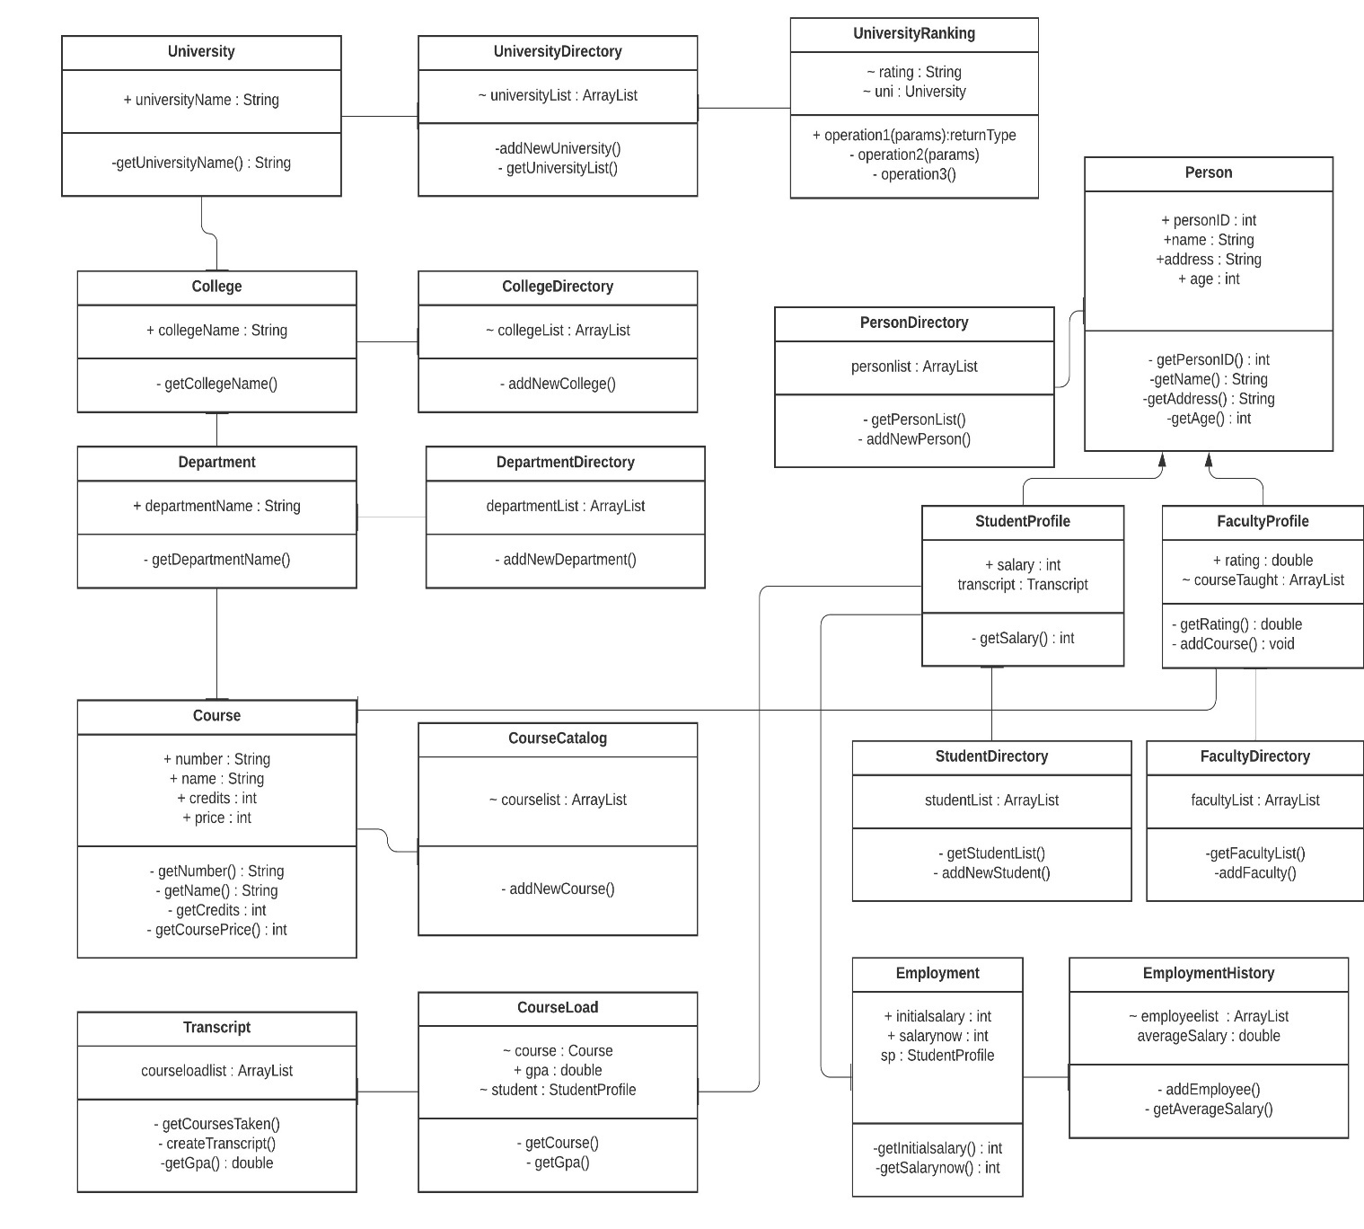
UML Diagram

Slide 3
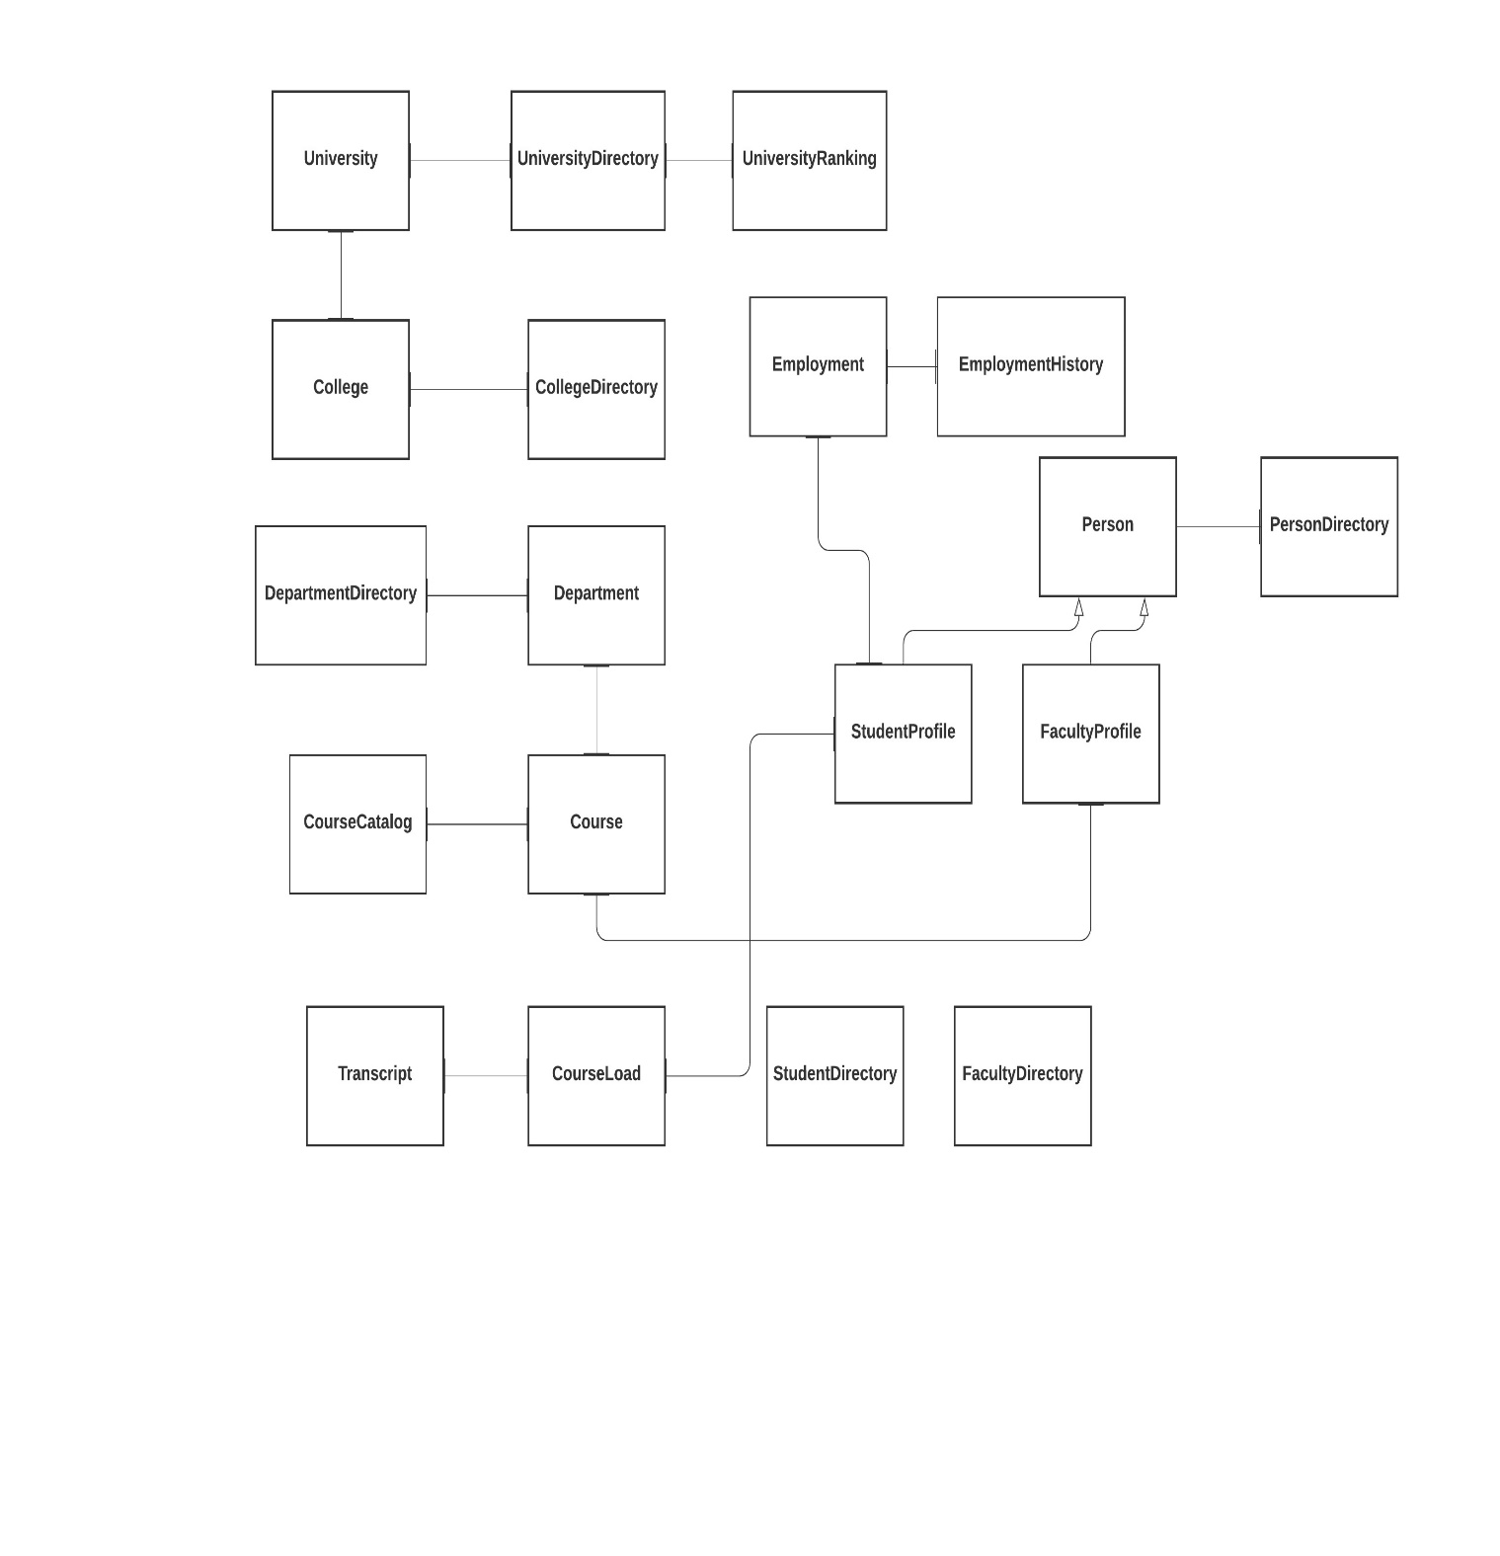
Object Model

Slide 4
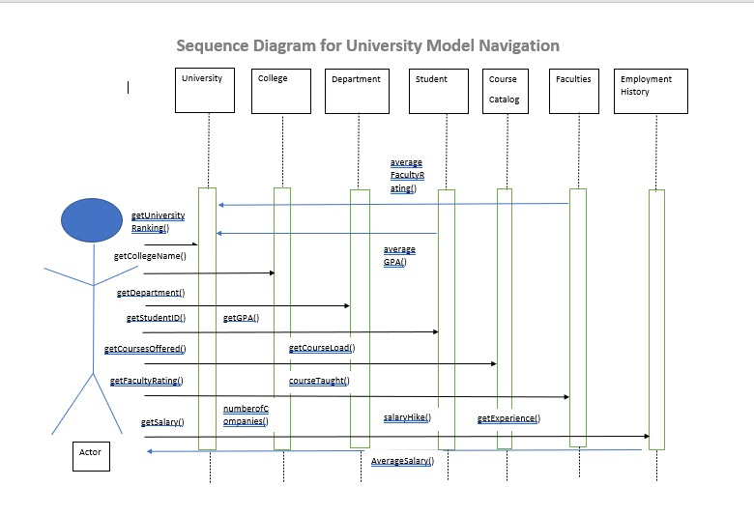
Sequence Diagram

Slide 5
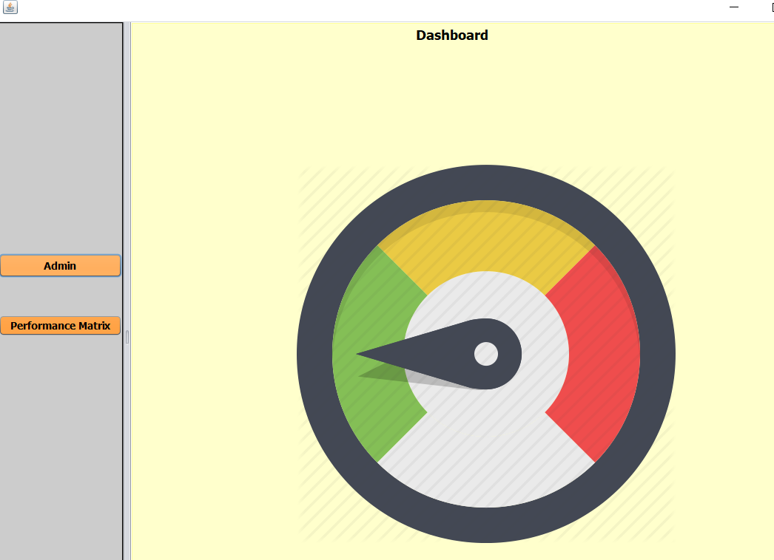
Dashboard

Slide 6
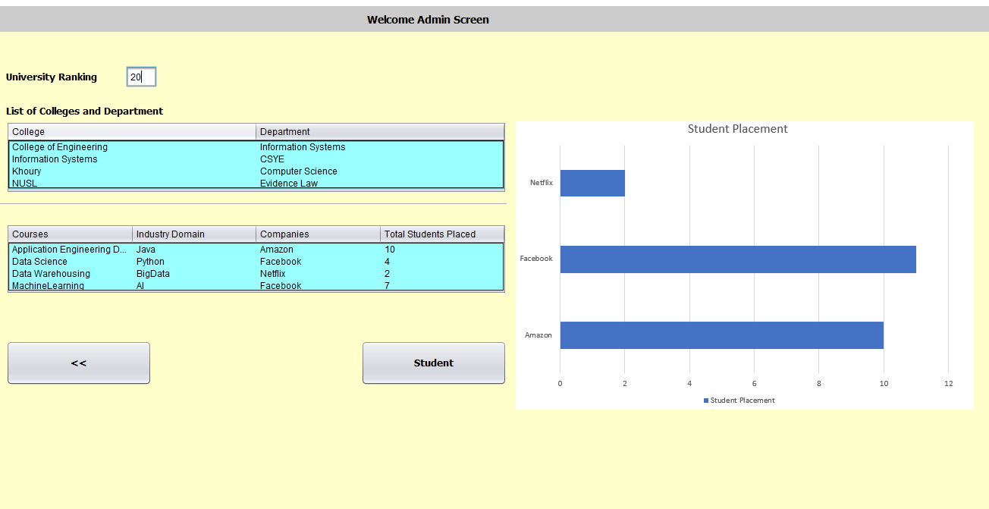

Slide 7
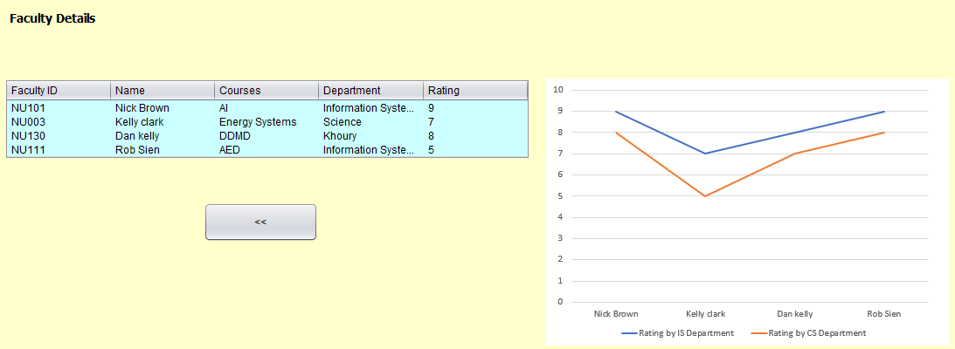

Slide 8
